Slide 1

HealthCare & BigData with Hadoop
Because Prevention is better than Cure
Presenter – Ashok

Slide 2





What will you learn today?
Challenges In Health Care
Health Care Wish List
Hadoop & Internet of Things
Hadoop’s role in HealthCare
DEMO with HealthCare DataSet

Slide 3
Challenges In HealthCare

Slide 4
Challenges In Health Care
Overdependence on manual caretaking
Observation is only available in hospitals
Continuous observation doesn’t happen
No mechanism for proper storage for huge healthcare data
No tracking of usage of medicines and equipments in hospital
Manual renewal of prescription

Slide 5
HealthCare Wish List

Slide 6
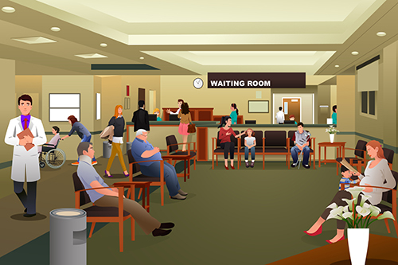




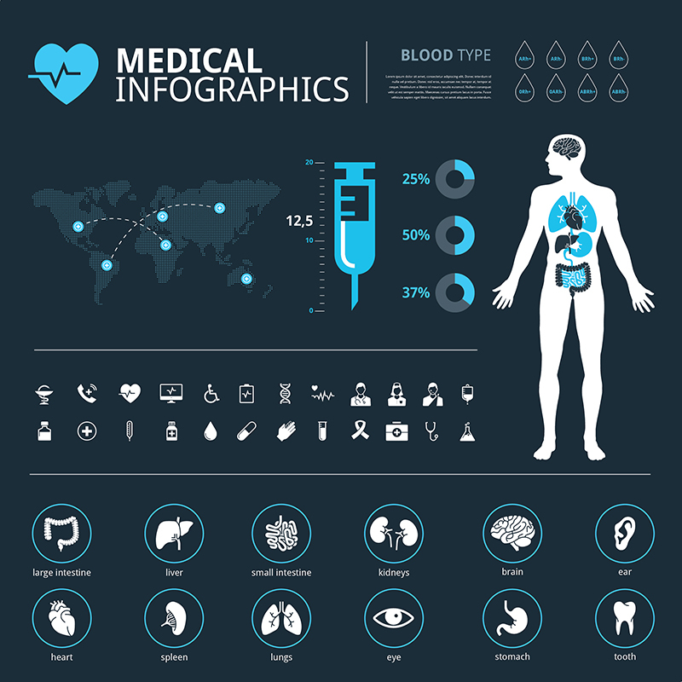


Wish List
Anticipation of Patient’s condition
Unnecessary doctor visit
Knowledge of facilities
Billing fraud
Anticipation of demands
Automatic renewal

Slide 7
Hadoop & Internet of Things

Slide 8












Hadoop & IoT
IoT is the network of physical devices embedded with electronics, software and sensors
Enable objects to exchange data within the existing Internet infrastructure
Results in improved efficiency, accuracy and economic benefit
Each device in the network is uniquely identifiable

Slide 9
Hadoop’s role in HealthCare

Slide 10
Hadoop’s role in HealthCare
Hadoop makes data less expensive and more available, giving Doctors more insight
Patients can wear a watch like device, which will take the body recordings and send it to the remotely located hospitals.
If the patient’s condition deteriorates, the doctor will be alerted about automatically

Slide 11
DEMO

Slide 12
Course Details

Slide 13

Certifications
Get Certified in Big Data & Hadoop by Edureka
Go to www.edureka.co/big-data-and-hadoop
Batch starts from 24 October (Weekend Batch)
Edureka's Big Data & Hadoop course:
Become a Hadoop Expert by mastering MapReduce, Yarn, Pig, Hive, HBase, Oozie, Flume and Sqoop while working on industry based Use-cases and Projects.
Online Live Courses: 30 hours
Assignments: 40 hours
Project: 20 hours
Lifetime Access + 24 X 7 Support

Slide 14
Thank You
Questions/Queries/Feedback
Recording and presentation will be made available to you within 24 hours

